Slide 1

Deploying Microservices on AWS Managed Kubernetes Platform
From Docker Containers to Amazon EKS
[Presenter Name] :

Slide 2
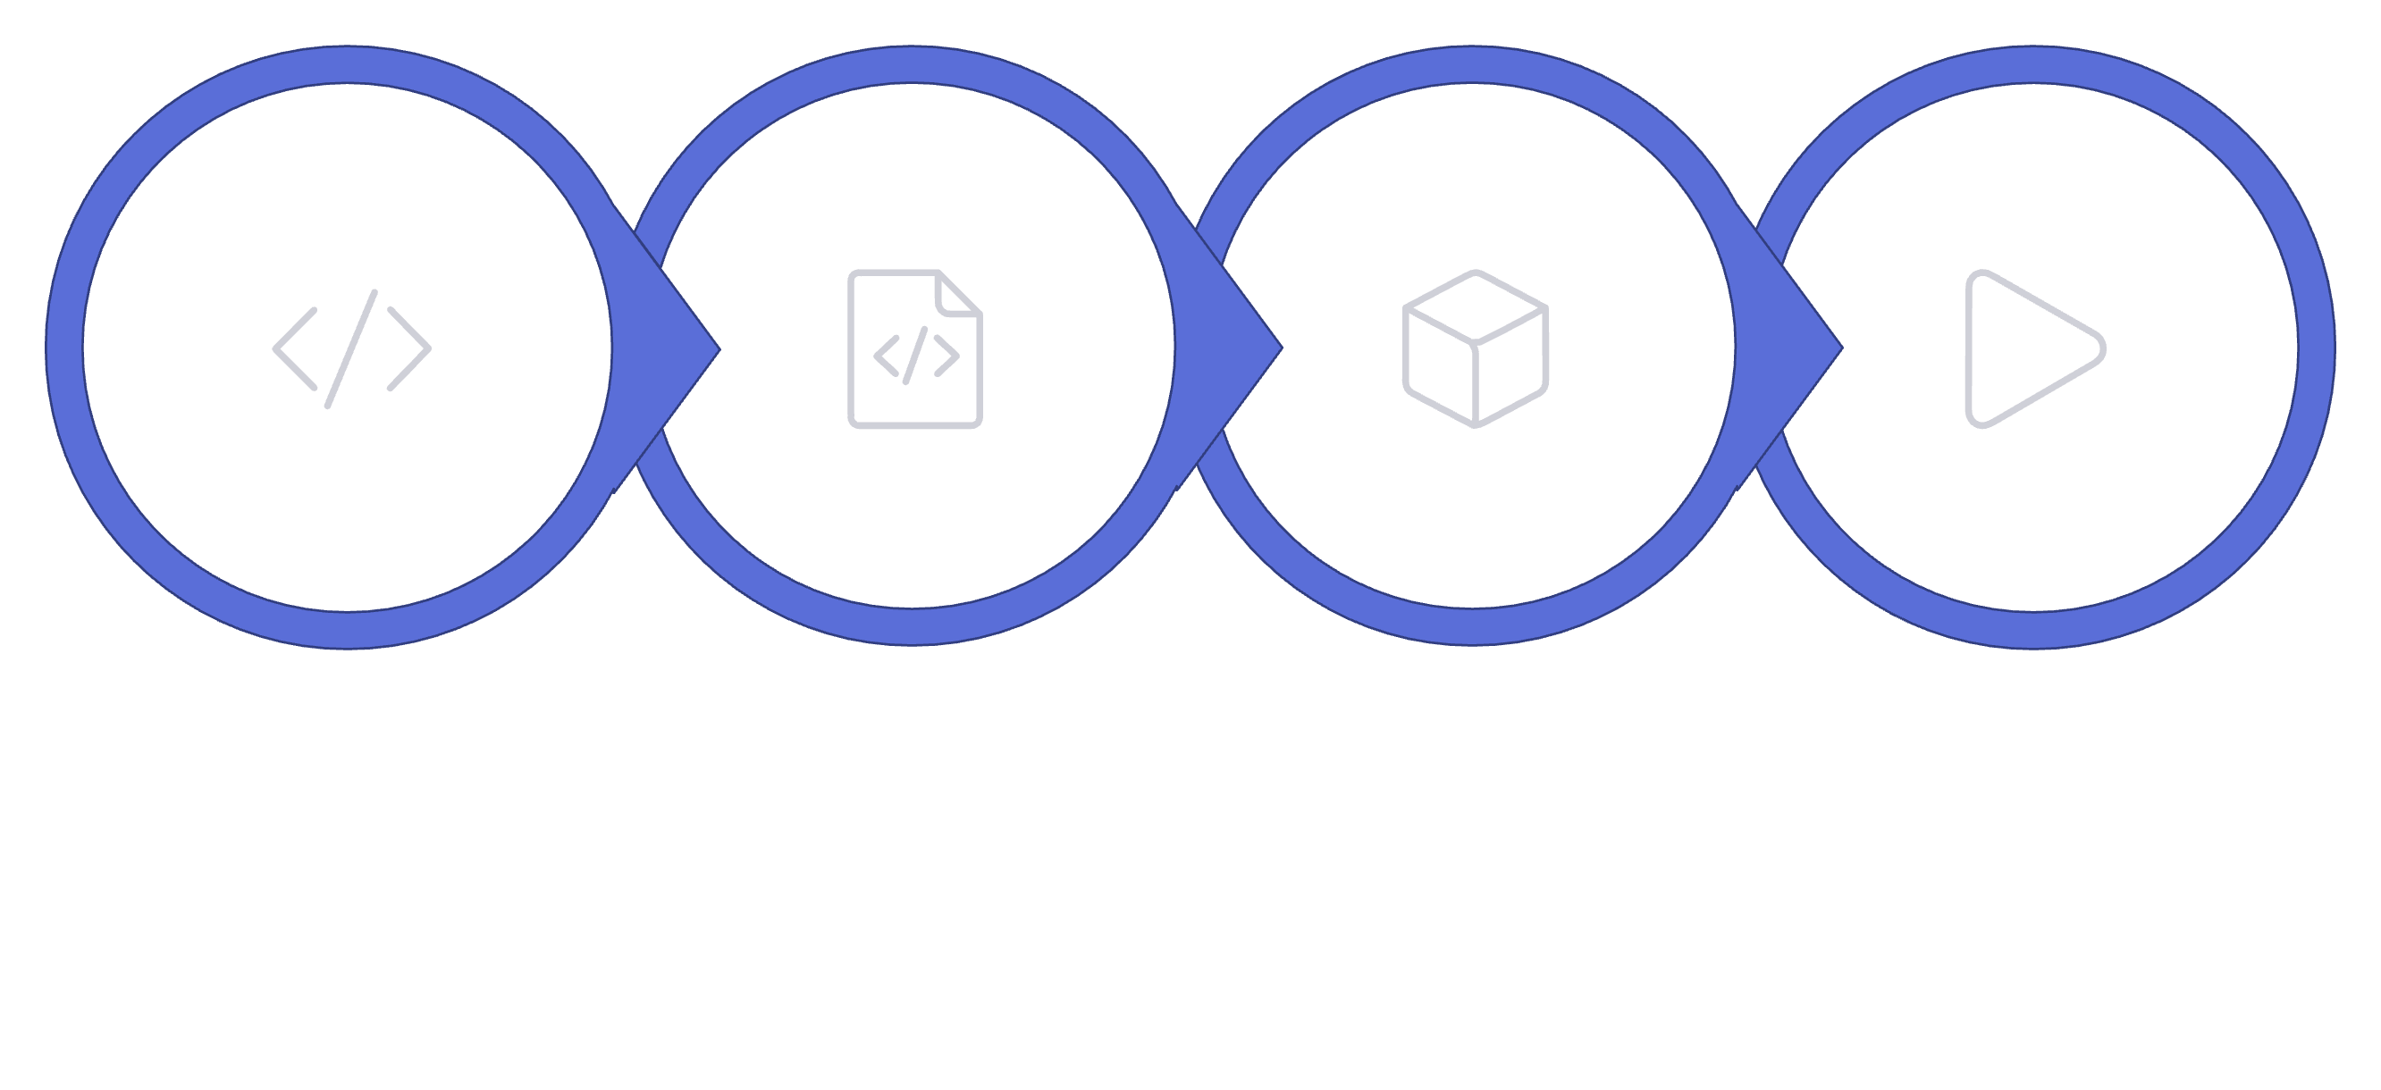
FOUNDATION
From Application to Container
Docker packages a microservice with its runtime, libraries, and configuration into a portable image — ensuring consistent behavior across all environments.
Microservice
Dockerfile
Docker Image
Container
Docker — standardizes packaging and distribution of applications
Containers — bundle the app with all dependencies, eliminating environment mismatch
Portability — runs identically on a laptop, on-premise server, or in the cloud

Slide 3
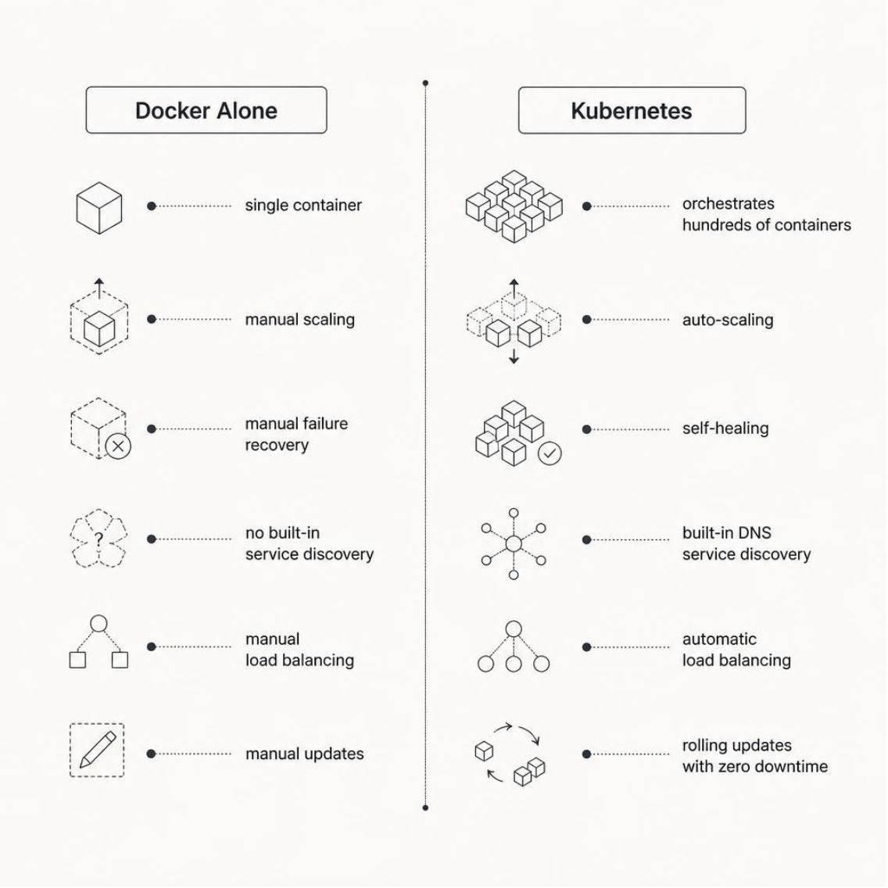

ORCHESTRATION
Why Do We Need Kubernetes?
Managing containers manually becomes unmanageable at scale. Kubernetes automates the operational burden.
Kubernetes orchestrates containerized workloads. Docker/container images provide the packaging; Kubernetes manages scheduling, scaling, and resilience. Modern clusters use runtimes like containerd or CRI-O.
Scaling
Self-Healing
Service Discovery
Rolling Updates
Auto-scale pods based on load
Restart failed containers automatically
Built-in DNS and load balancing
Zero-downtime deployments

Slide 4
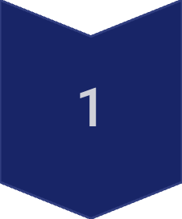
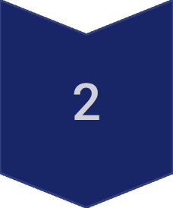
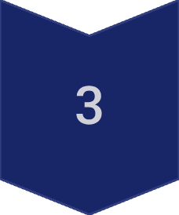
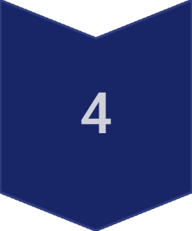
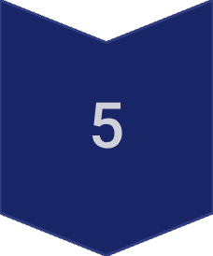
CORE CONCEPTS
What Is Kubernetes?
Kubernetes is an open-source platform for automating deployment, scaling, and management of containerized applications — originally developed by Google and now maintained by the CNCF.
Container
Isolated process with app and dependencies
Pod
Smallest deployable unit — wraps one or more containers
Deployment
Manages Pod replicas and rolling updates
Service
Stable network endpoint for accessing Pods
Cluster
Set of nodes running your workloads

Slide 5
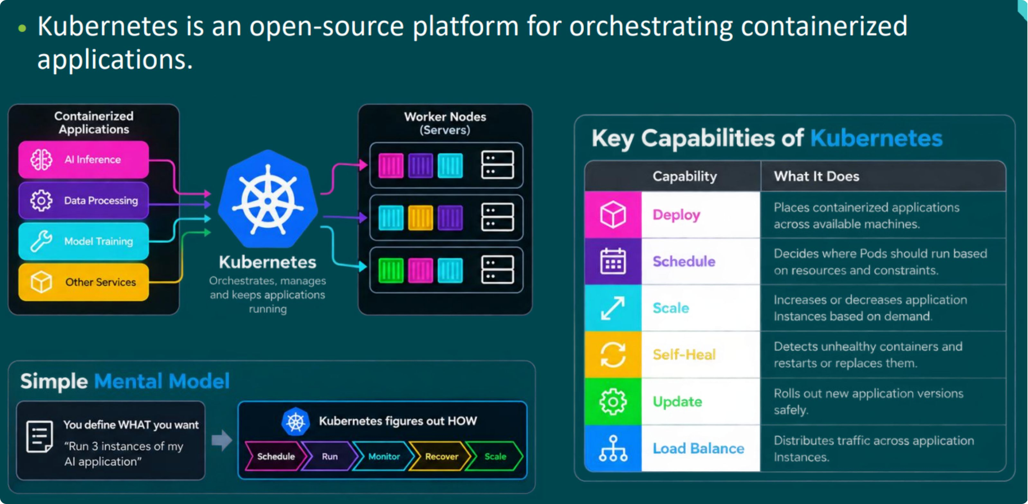
Kubernetes Overview

Slide 6
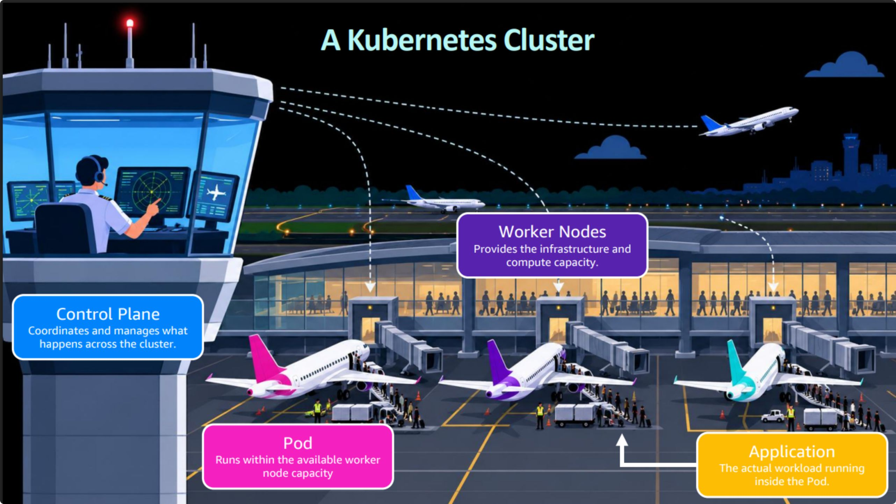
Kubernetes as an Airport Analogy
Kubernetes works like a busy airport, coordinating many moving parts so the right workloads are in the right place at the right time.
Control Plane
Nodes
Pods
Containers
Air Traffic Controller
Terminals/Gates
Airplanes
Passengers

Slide 7
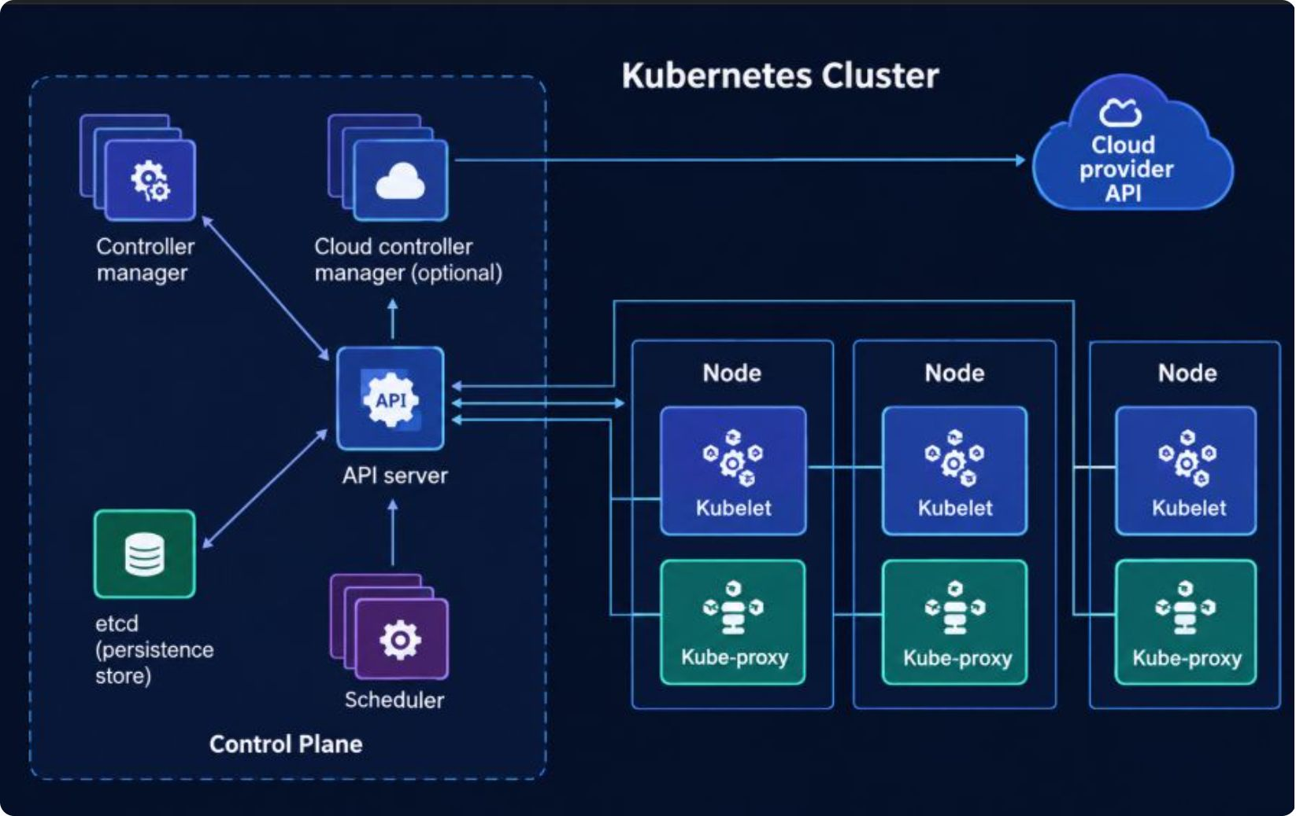
ARCHITECTURE
Kubernetes Cluster Architecture
The Control Plane manages cluster state; Worker Nodes run your application workloads. The API Server is the single communication interface for all interactions.
Control Plane
kube-apiserver — front-end for all cluster communication
etcd — consistent key-value store for cluster state
kube-scheduler — assigns Pods to suitable Nodes
kube-controller-manager — runs controllers that reconcile state
Worker Node
kubelet — agent that manages Pods on the Node
kube-proxy — maintains network rules for Services
Container Runtime — runs containers (containerd, CRI-O)
Pods — host the application containers

Slide 8
CORE OBJECTS
Core Kubernetes Objects
Each object has a specific role. The Pod is the smallest deployable unit in Kubernetes.
Pod
Deployment
Wraps one or more containers with shared network and storage
Manages Pod replicas and rolling updates
ReplicaSet
Service
Ensures the desired number of Pod replicas are running
Stable DNS name and load-balanced access to Pods
ConfigMap / Secret
Namespace
Store configuration and sensitive data separately from code
Virtual cluster for isolating resources within a cluster

Slide 9
CONFIGURATION
Pod & Service YAML
Pod YAML
Service YAML
apiVersion: v1
kind: Pod
metadata:
name: user-pod
labels:
app: user-service
spec:
containers:
- name: user-service
image: user-service:v1
ports:
- containerPort: 8080
apiVersion: v1
kind: Service
metadata:
name: user-service
spec:
selector:
app: user-service # Finds matching Pods
ports:
- port: 80 # Service port
targetPort: 8080 # Container port
type: LoadBalancer # Exposes externally
port
targetPort
type
Port exposed by the Service
Port on the Pod receiving traffic
ClusterIP · NodePort · LoadBalancer

Slide 10

AMAZON EKS
Why Use Amazon EKS?
Amazon EKS is AWS's managed Kubernetes service — running upstream Kubernetes with AWS-managed control plane and deep AWS integration.
Self-Managed Kubernetes
Amazon EKS
You operate and maintain the control plane
You manage high availability and upgrades
Full operational responsibility
AWS manages the control plane across AZs
Deep integration with VPC, IAM, ECR, CloudWatch
Managed Node Groups, Karpenter, or EKS Auto Mode for data plane
EKS manages the control plane. Data-plane management depends on configuration: Managed Node Groups, Karpenter, or EKS Auto Mode.

Slide 11
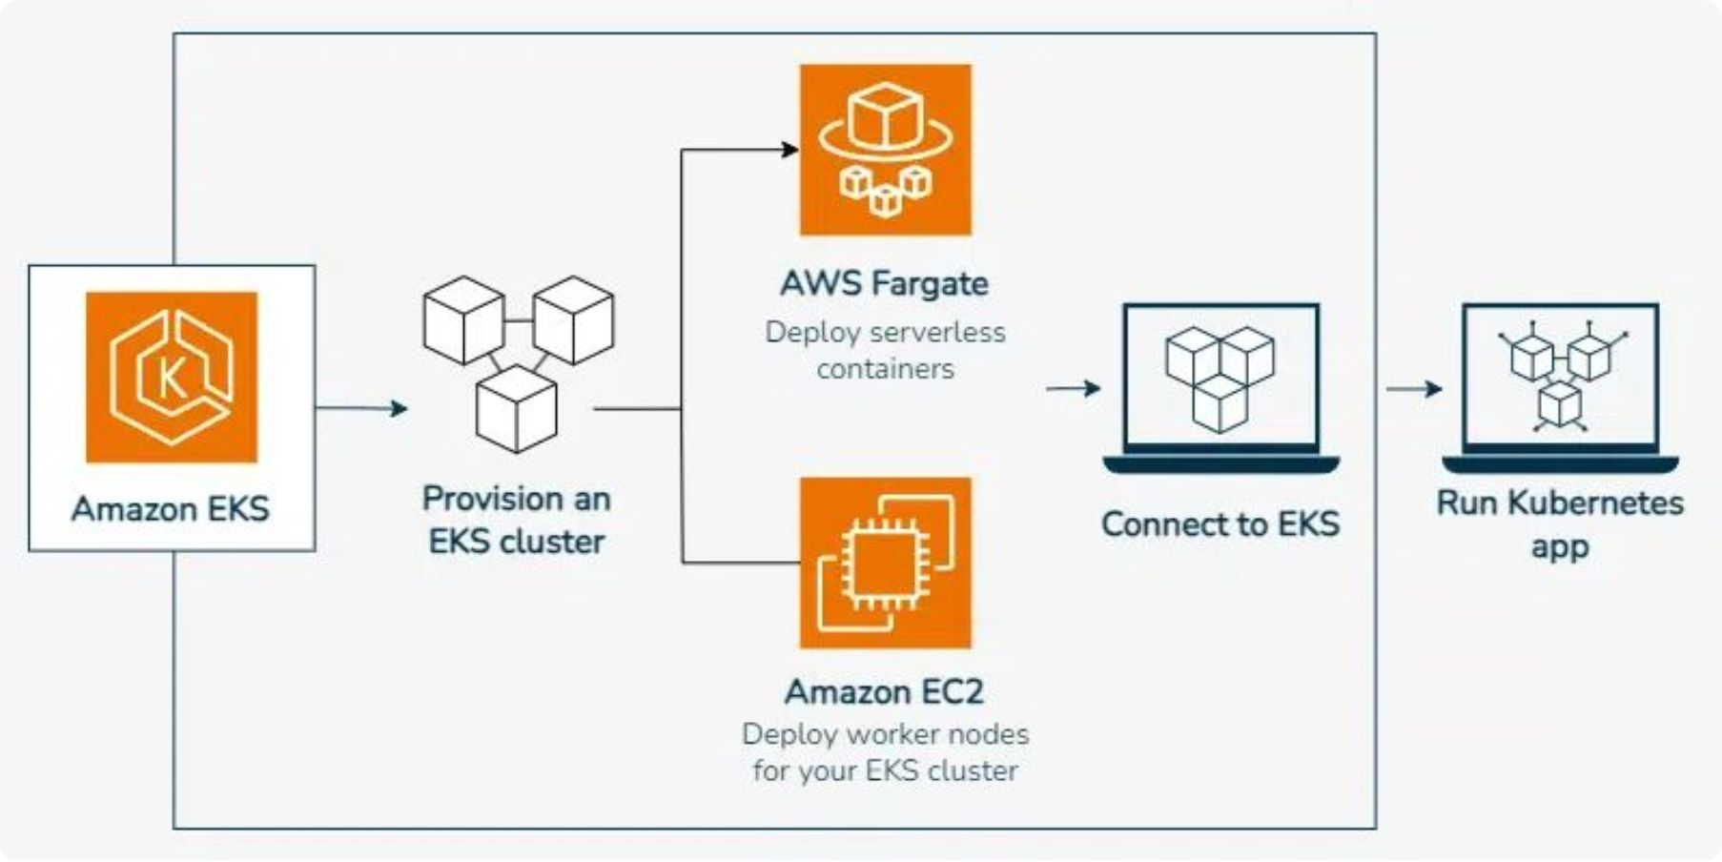
AMAZON EKS
Amazon EKS Architecture
Managed Control Plane
API Server, etcd, Scheduler, Controller Manager
Distributed across multiple Availability Zones
Automated upgrades and patching by AWS
Data Plane (Worker Nodes)
EC2 instances, Fargate, or Outposts
Runs kubelet, kube-proxy, and container runtime
Hosts Pods running your microservices
Developer Workflow
Developer → kubectl / AWS Console → EKS API → Control Plane → Worker Nodes → Pods → Microservices

Slide 12
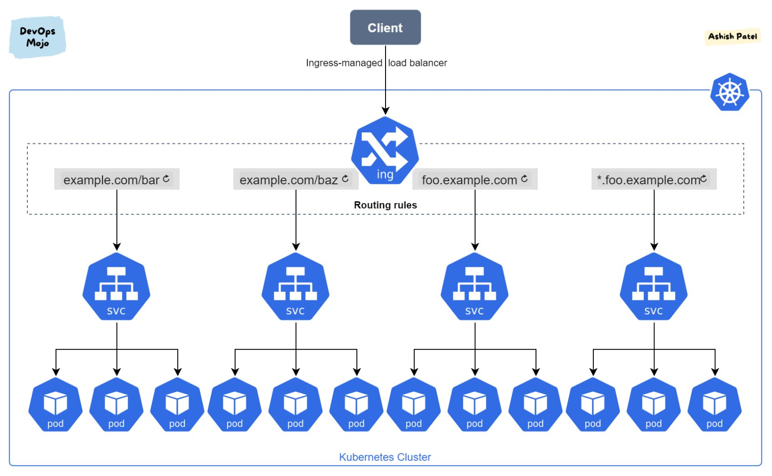
NETWORKING
Kubernetes Ingress & Networking
Client
Ingress Controller
External users or applications
Routes traffic based on rules
Services
Pods
Group Pods and provide stable endpoints
Individual containers running the application

Slide 13
Key Takeaways
1
2
3
Docker
Kubernetes
Amazon EKS
Packages microservices into containers
Automates deployment, scaling & management
Provides managed Kubernetes on AWS

Slide 14
Thank You
We appreciate your time and attention.
Any Questions?

